Slide 1


Project Title: Smart Surveillance System (SSS)

Slide 2
Team
Abdullah Basit | 20I-0623
Muhammad Abubakar Siddique | 20F-0101
Supervisor
Mr. Usman Ghous

Slide 3
Outline
Introduction
Revisions
Committed Use Cases
Video Demonstration
Web App Interface
Face Detection and Recognition
Live Demo

Slide 4
Project Introduction
SSS is a pioneering solution addressing surveillance gaps in university CCTV systems. It integrates facial recognition, computer vision, and behavior analysis for comprehensive monitoring. By proactively identifying and tracking specific behaviors, such as smoking or fighting, it overcomes human limitations in overseeing multiple cameras, ensuring continuous monitoring and precise risk management.

Slide 5
Revision
In our last review, the panel recommended that our system should continue utilizing a procedural approach, as it sufficiently meets the project's requirements without the need for object-oriented diagrams. Following this guidance, we have removed all object-oriented approach diagrams and are exclusively using procedural diagrams. Additionally, the Entity-Relationship Diagram (ERD) has been updated to include the 'login' and 'reports' tables as per the panel's suggestions.

Slide 6
Commitment
Login
Identifying Individuals (Facial Recognition)
Manage Data
View Data Summary
Notes:
Generalization: smoking behavior (child inherits) and adds to parent detect behavior
Include: included use case detect behavior never stands alone, it occurs because address alert is a greater significant use case
Extend: base can stand alone (view data) but extension can be done on its behavior under certain conditions by another use case (search and filter)

Slide 7
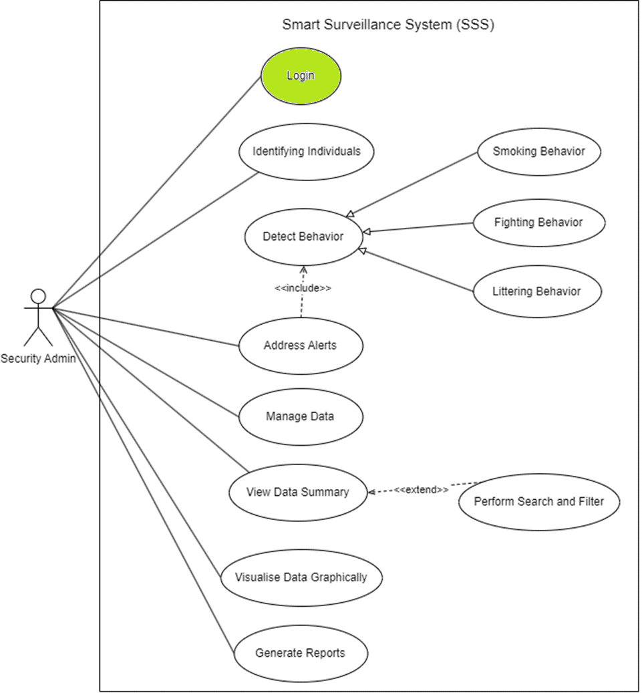
Committed Use Cases
Login
Identifying Individuals (Facial Recognition)
Manage Data
View Data Summary
Notes:
Generalization: smoking behavior (child inherits) and adds to parent detect behavior
Include: included use case detect behavior never stands alone, it occurs because address alert is a greater significant use case
Extend: base can stand alone (view data) but extension can be done on its behavior under certain conditions by another use case (search and filter)

Slide 8
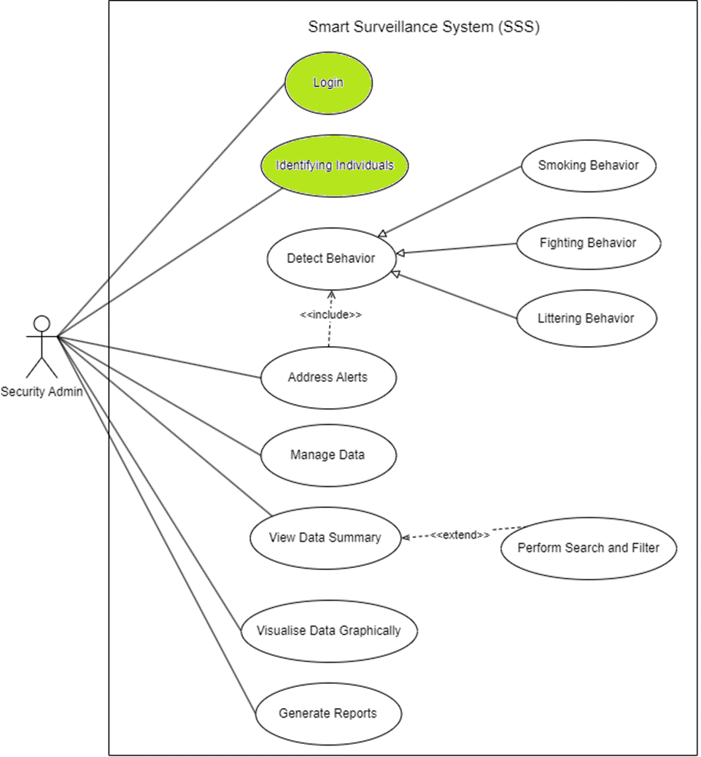
Committed Use Cases
Login
Identifying Individuals (Facial Recognition)
Manage Data
View Data Summary
Notes:
Generalization: smoking behavior (child inherits) and adds to parent detect behavior
Include: included use case detect behavior never stands alone, it occurs because address alert is a greater significant use case
Extend: base can stand alone (view data) but extension can be done on its behavior under certain conditions by another use case (search and filter)

Slide 9
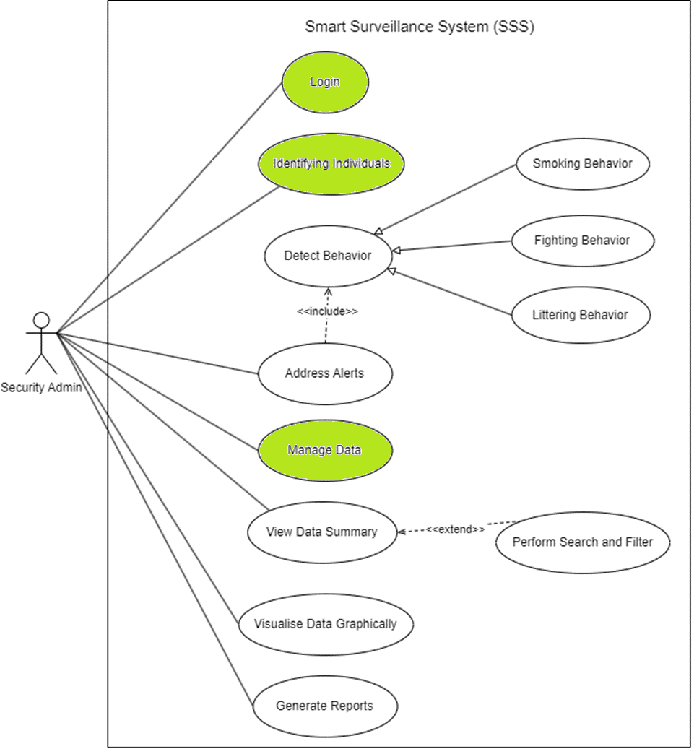
Committed Use Cases
Login
Identifying Individuals (Facial Recognition)
Manage Data
View Data Summary
Notes:
Generalization: smoking behavior (child inherits) and adds to parent detect behavior
Include: included use case detect behavior never stands alone, it occurs because address alert is a greater significant use case
Extend: base can stand alone (view data) but extension can be done on its behavior under certain conditions by another use case (search and filter)

Slide 10
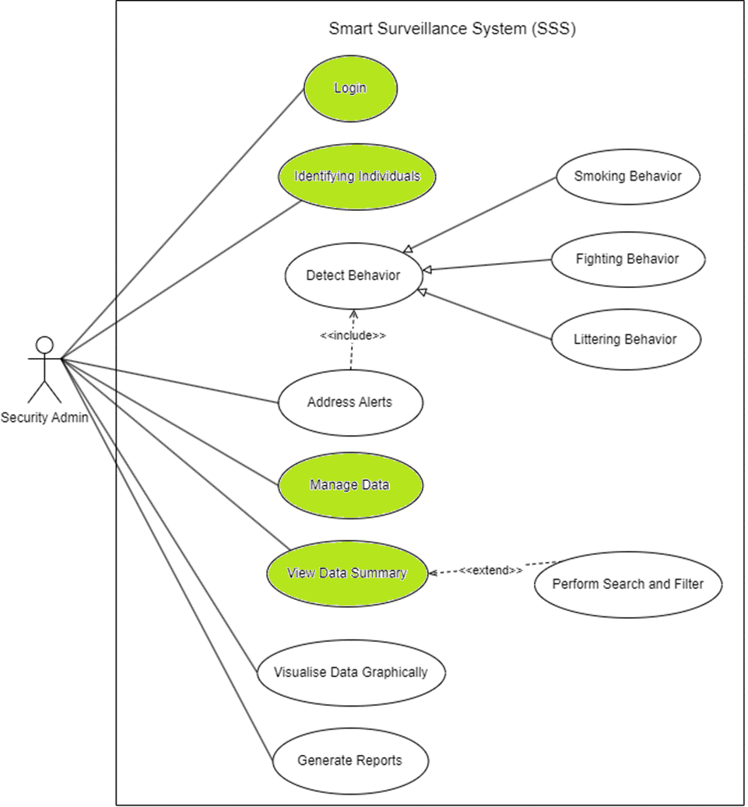
Committed Use Cases
Login
Identifying Individuals (Facial Recognition)
Manage Data
View Data Summary
Notes:
Generalization: smoking behavior (child inherits) and adds to parent detect behavior
Include: included use case detect behavior never stands alone, it occurs because address alert is a greater significant use case
Extend: base can stand alone (view data) but extension can be done on its behavior under certain conditions by another use case (search and filter)

Slide 11
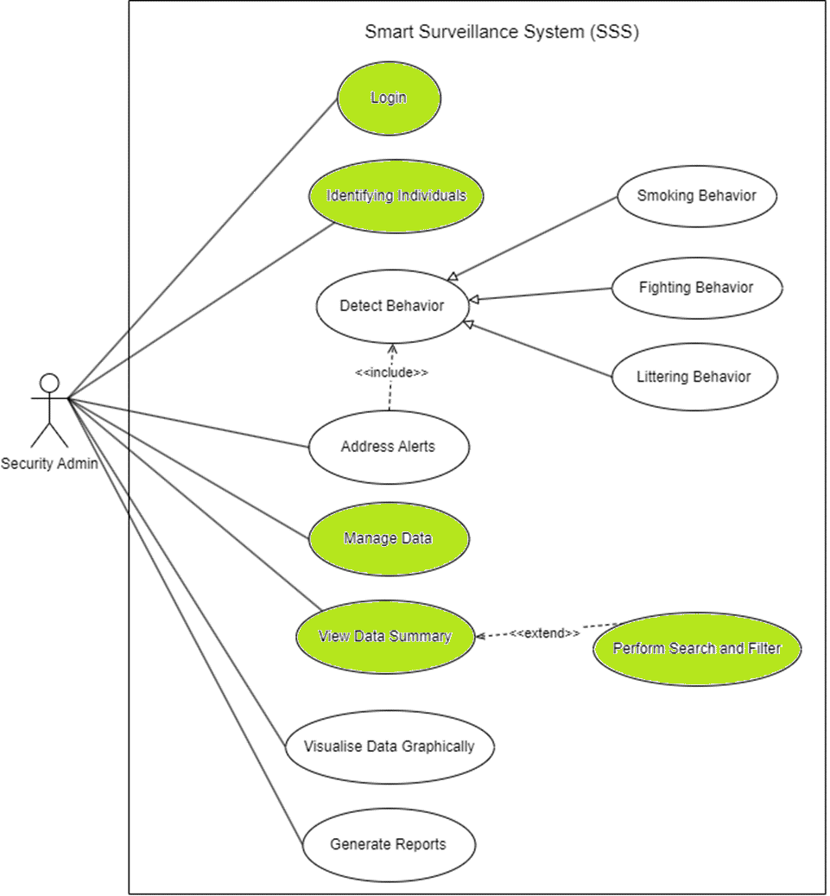
Committed Use Cases
Login
Identifying Individuals (Facial Recognition)
Manage Data
View Data Summary
Notes:
Generalization: smoking behavior (child inherits) and adds to parent detect behavior
Include: included use case detect behavior never stands alone, it occurs because address alert is a greater significant use case
Extend: base can stand alone (view data) but extension can be done on its behavior under certain conditions by another use case (search and filter)

Slide 12
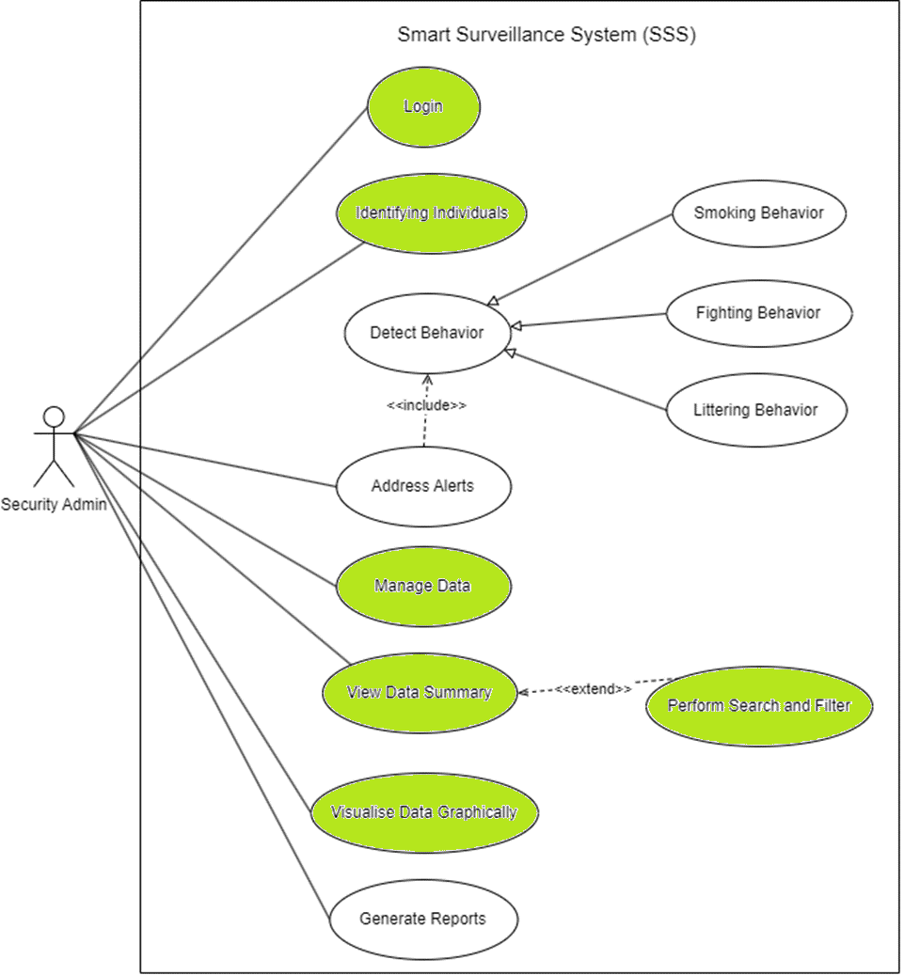
Committed Use Cases
Login
Identifying Individuals (Facial Recognition)
Manage Data
View Data Summary
Visualize Data Graphically
Notes:
Generalization: smoking behavior (child inherits) and adds to parent detect behavior
Include: included use case detect behavior never stands alone, it occurs because address alert is a greater significant use case
Extend: base can stand alone (view data) but extension can be done on its behavior under certain conditions by another use case (search and filter)

Slide 13
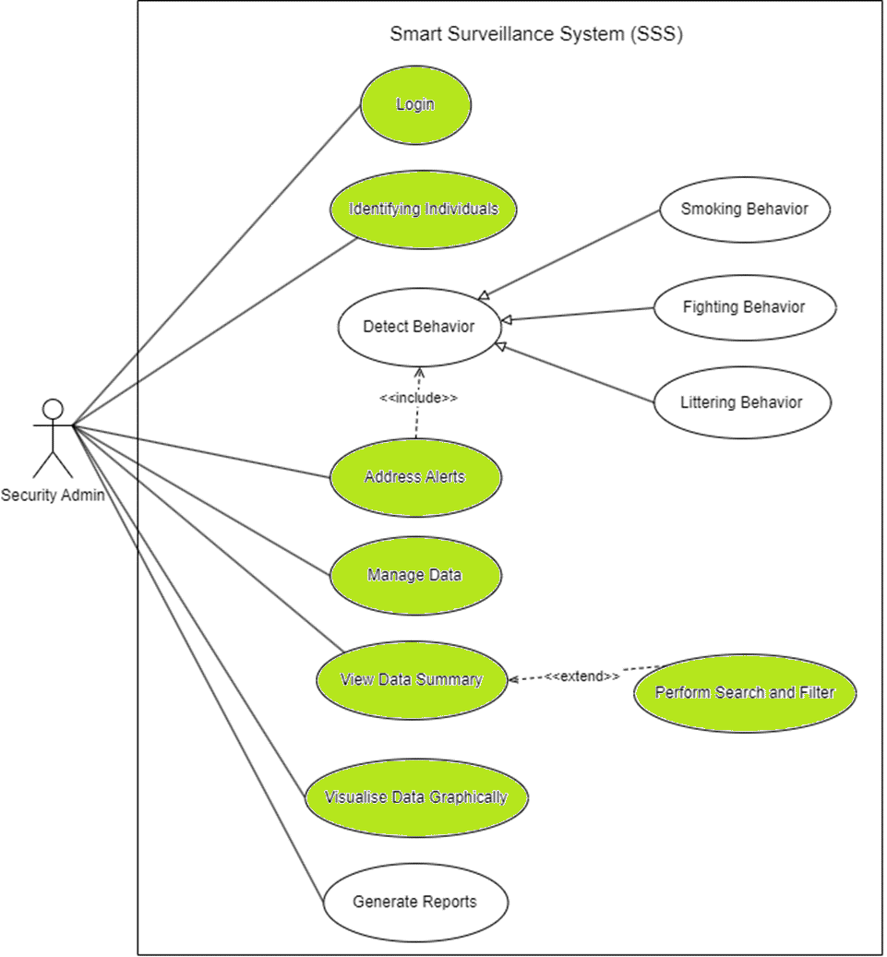
Committed Use Cases
Login
Identifying Individuals (Facial Recognition)
Manage Data
View Data Summary
Visualize Data Graphically
Address Alerts
Notes:
Generalization: smoking behavior (child inherits) and adds to parent detect behavior
Include: included use case detect behavior never stands alone, it occurs because address alert is a greater significant use case
Extend: base can stand alone (view data) but extension can be done on its behavior under certain conditions by another use case (search and filter)

Slide 14
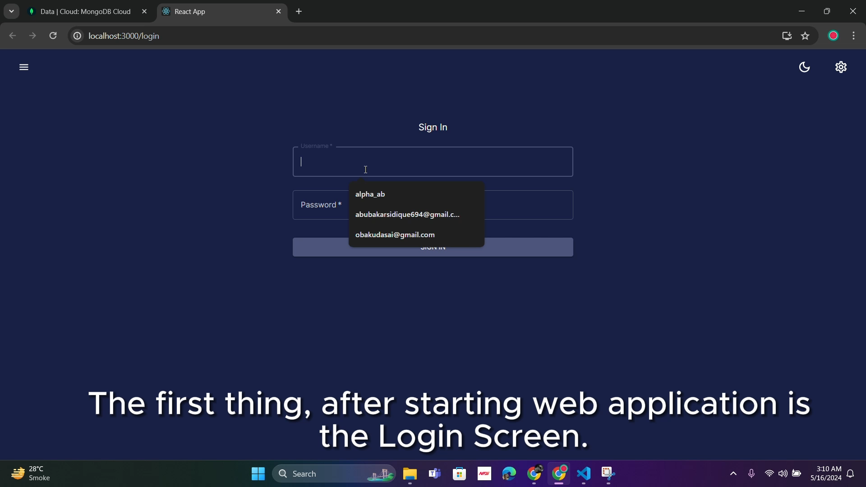
Video Demonstration

Slide 15
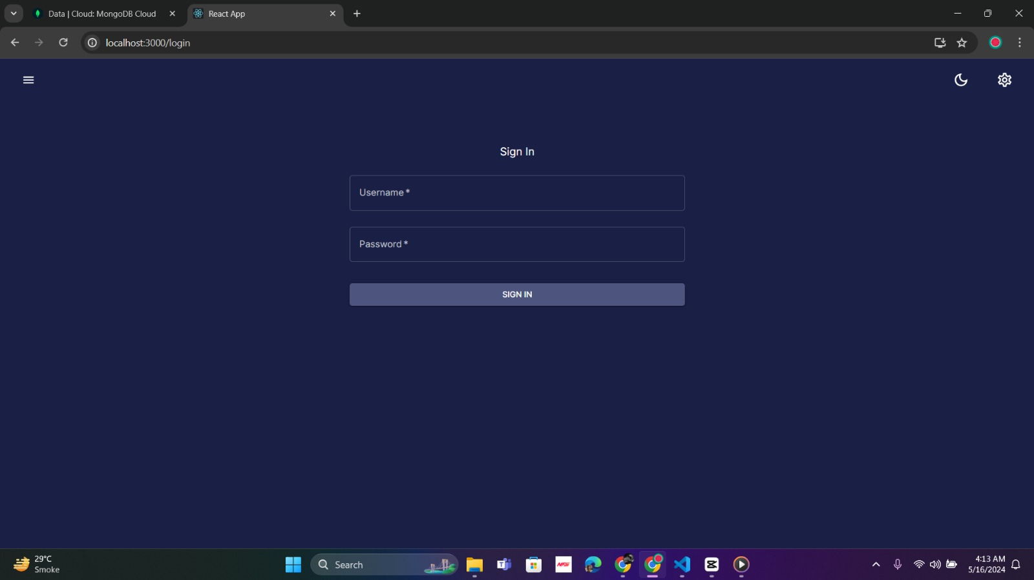
App Interface

Slide 16
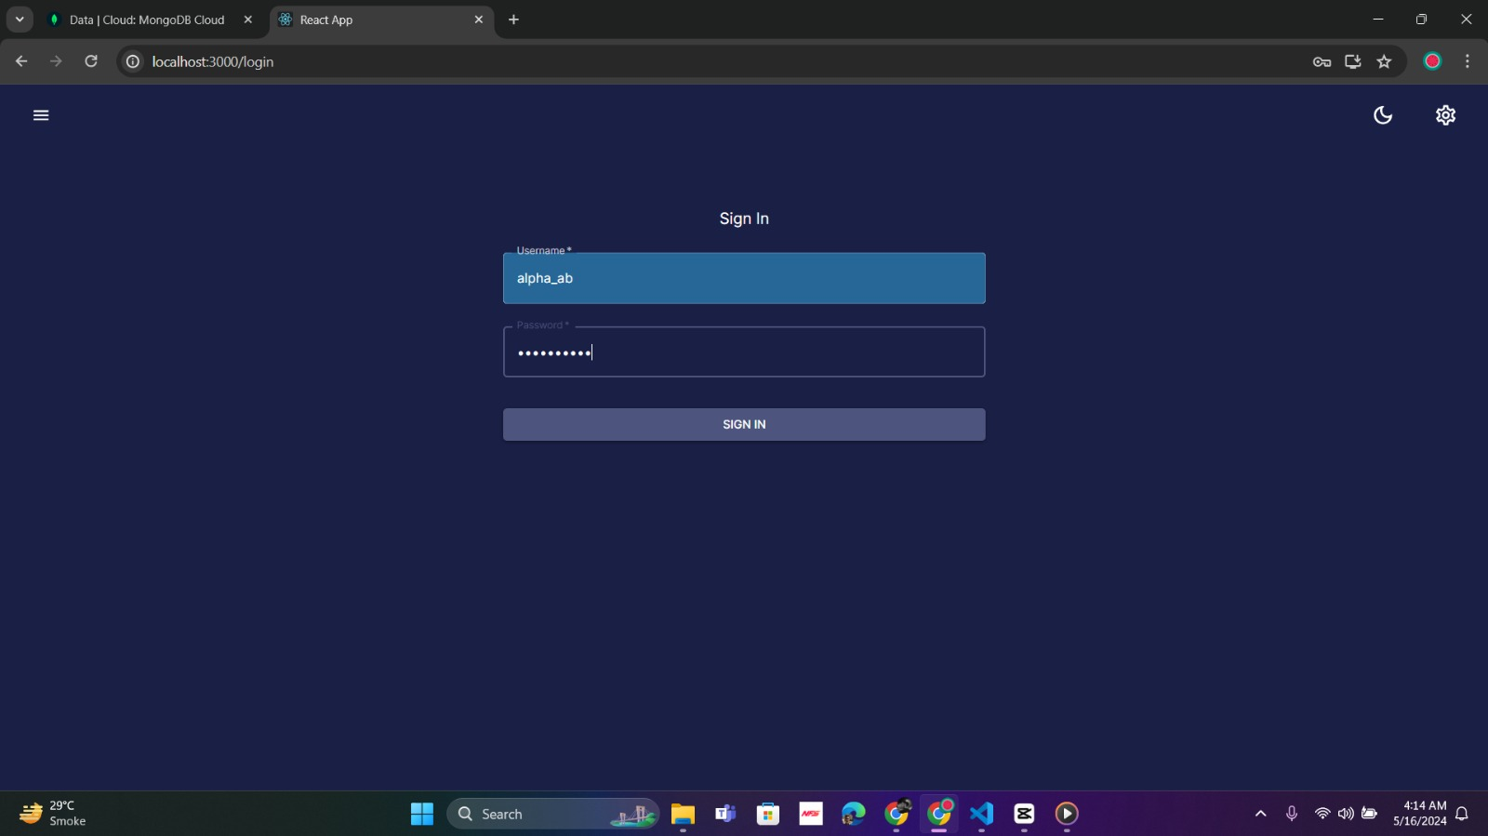
App Interface

Slide 17
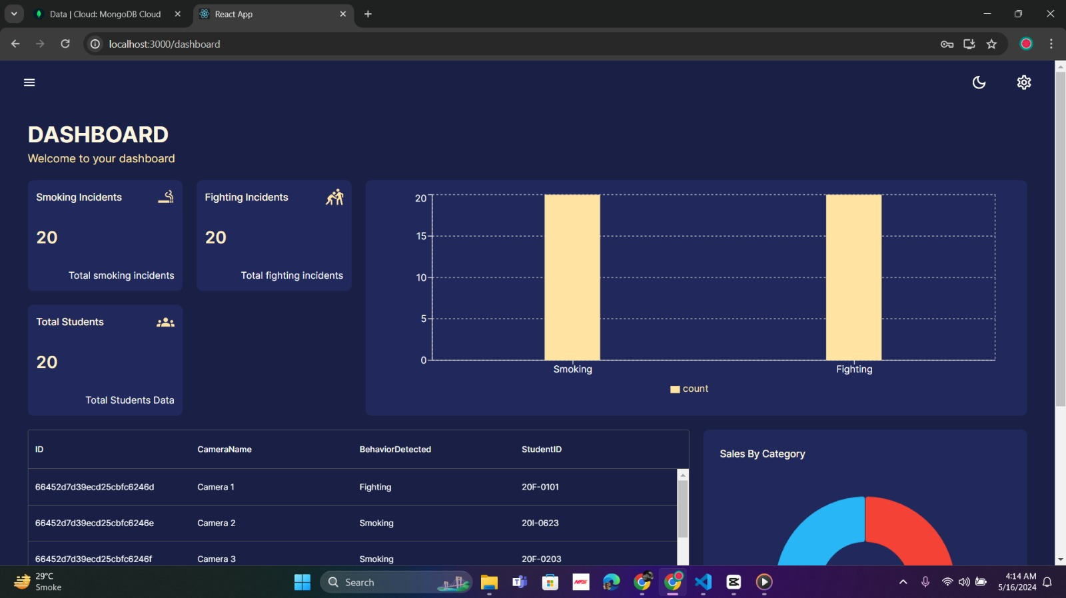
App Interface

Slide 18
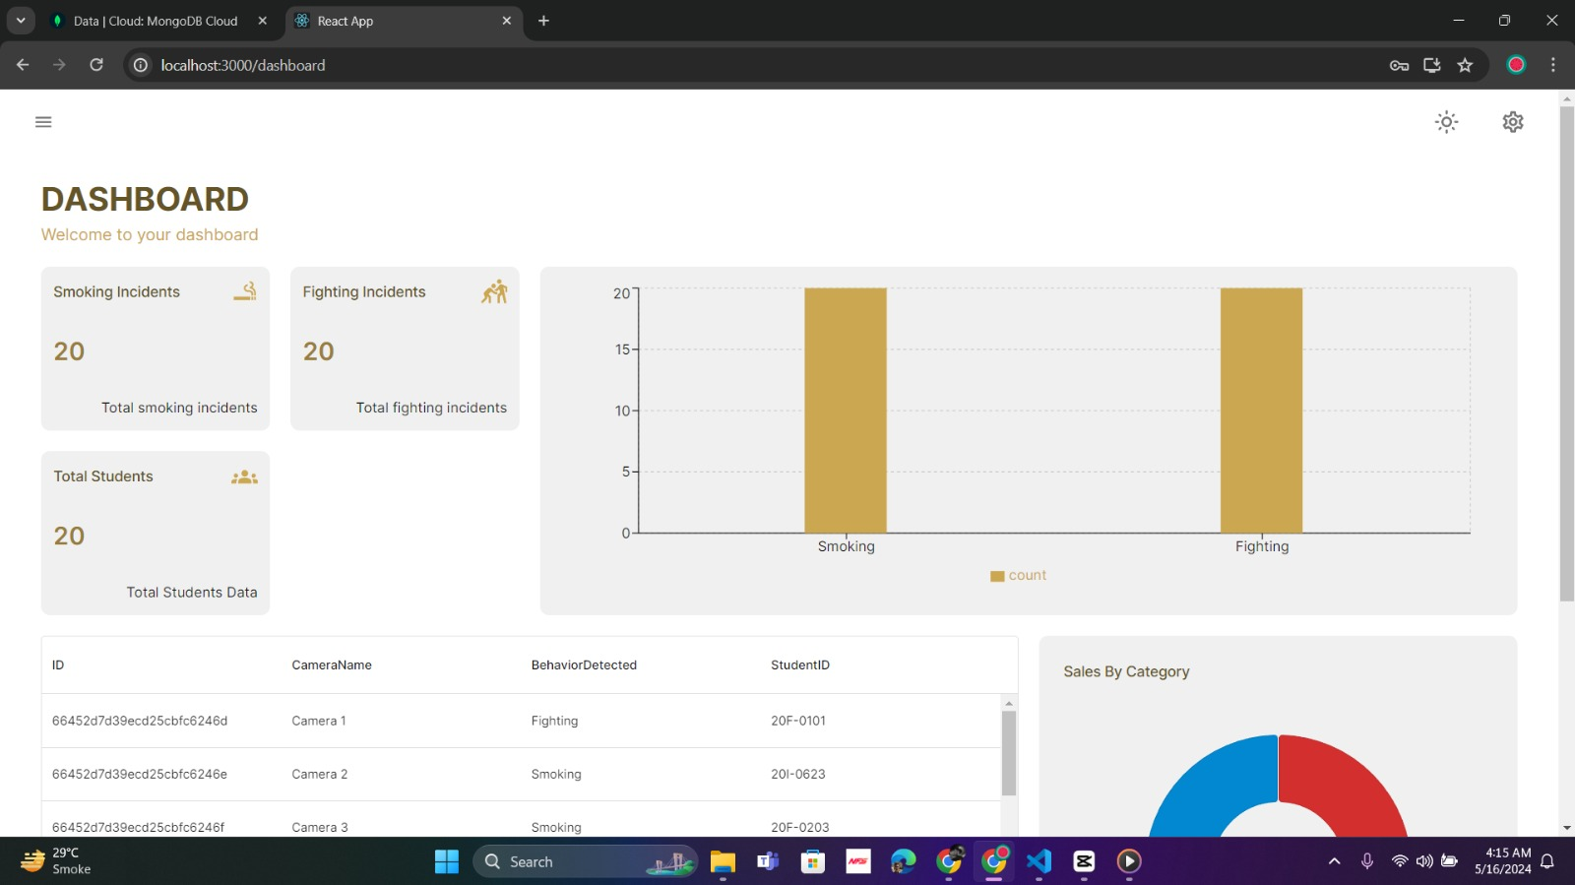
App Interface

Slide 19
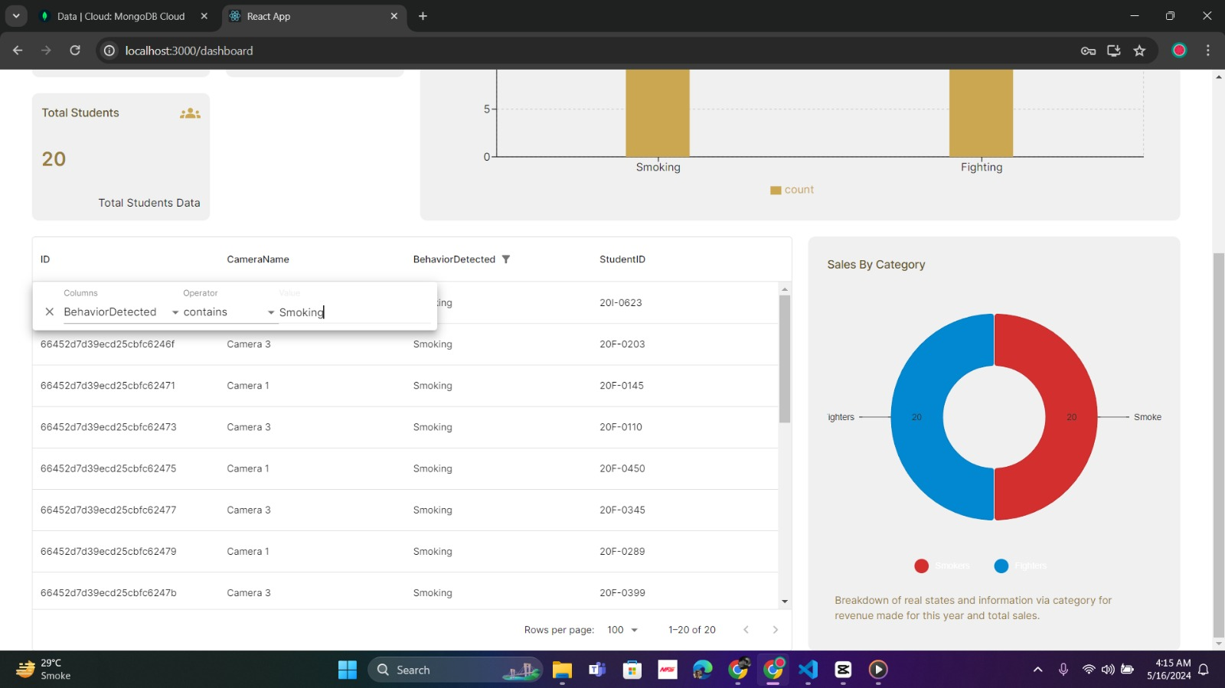
App Interface

Slide 20
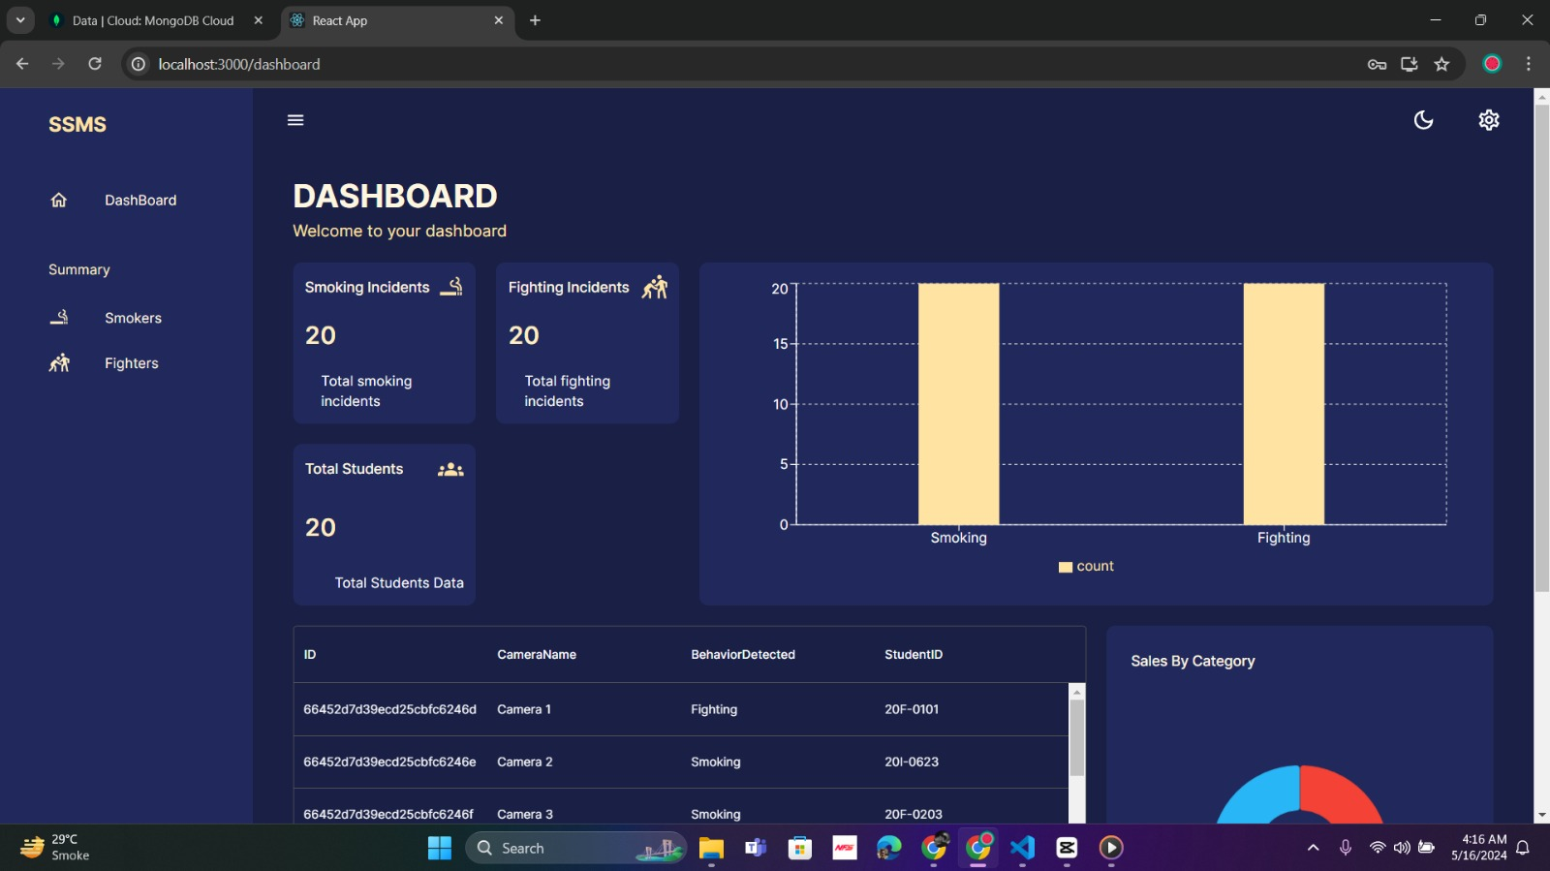
App Interface

Slide 21
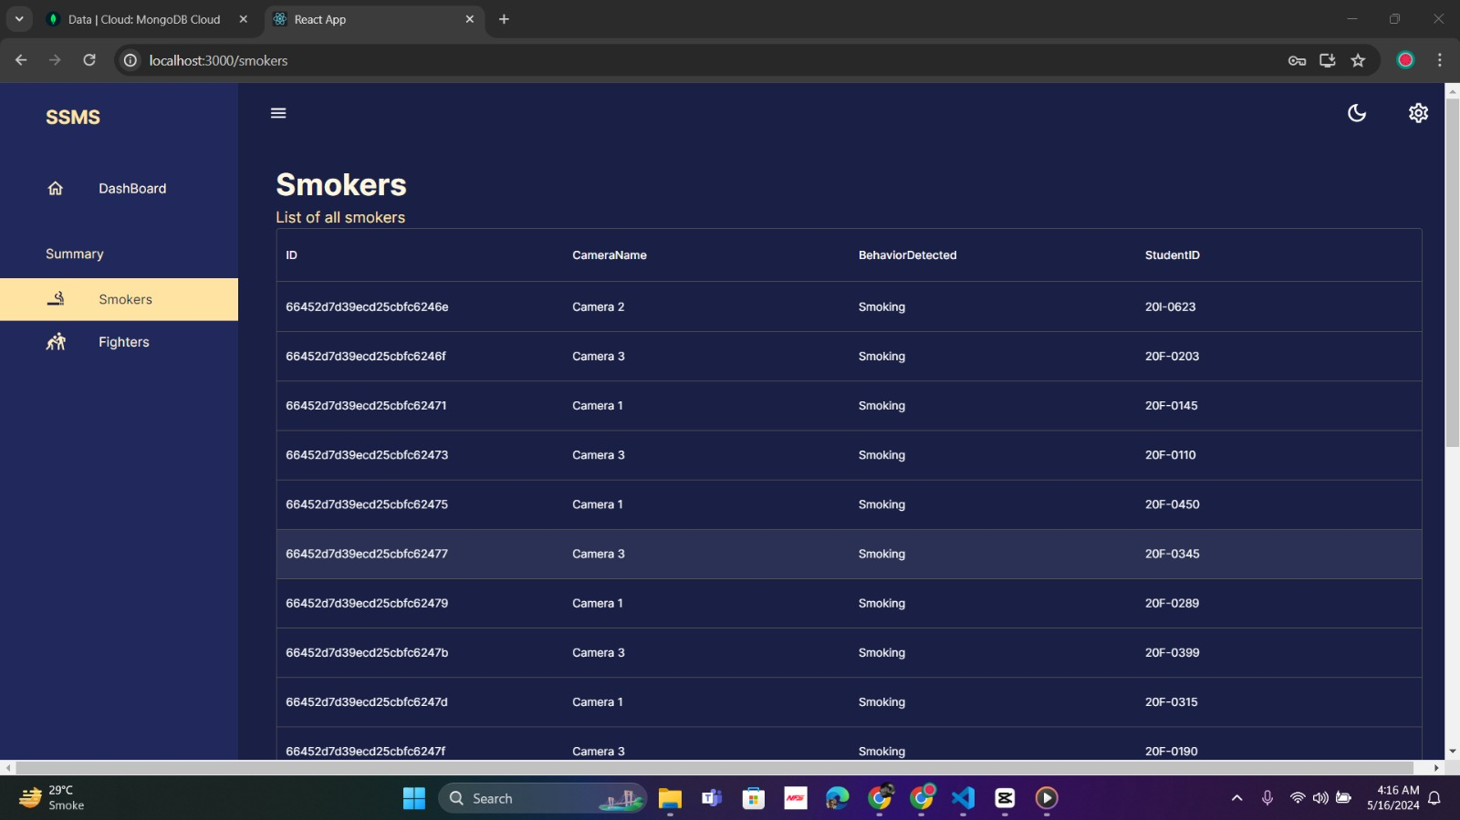
App Interface

Slide 22
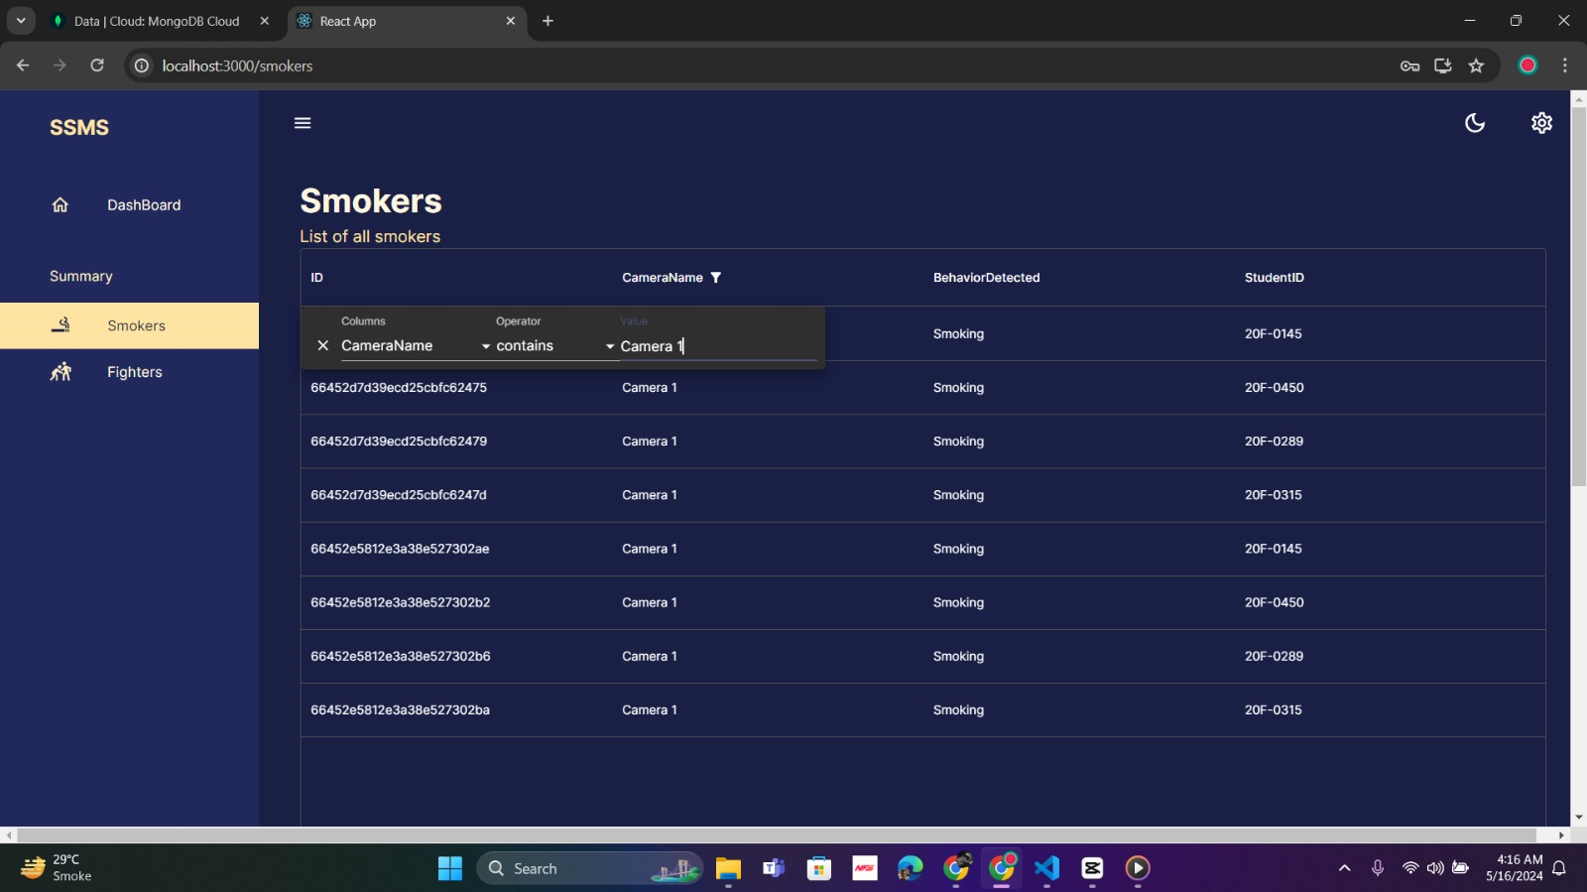
App Interface

Slide 23
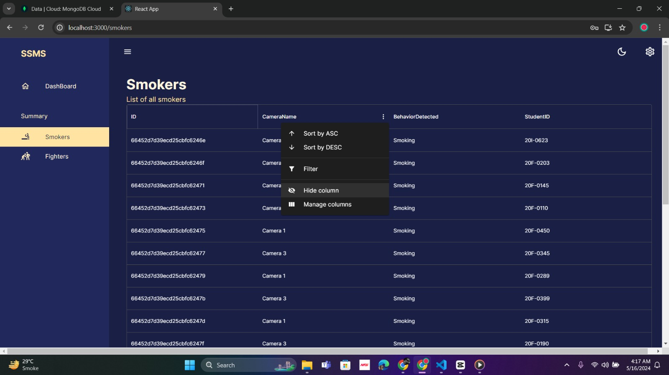
App Interface

Slide 24
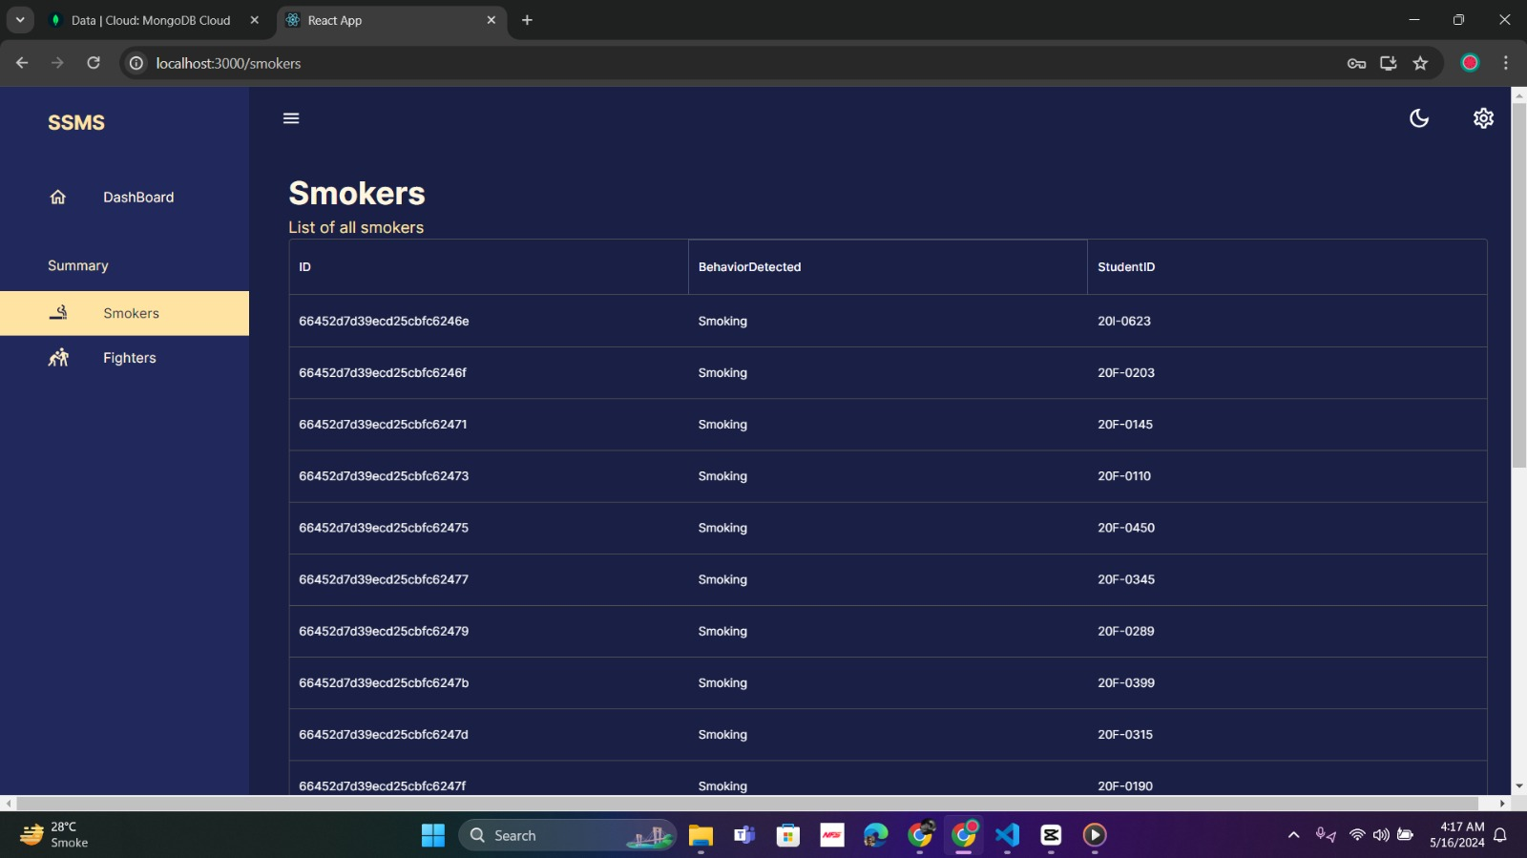
App Interface

Slide 25
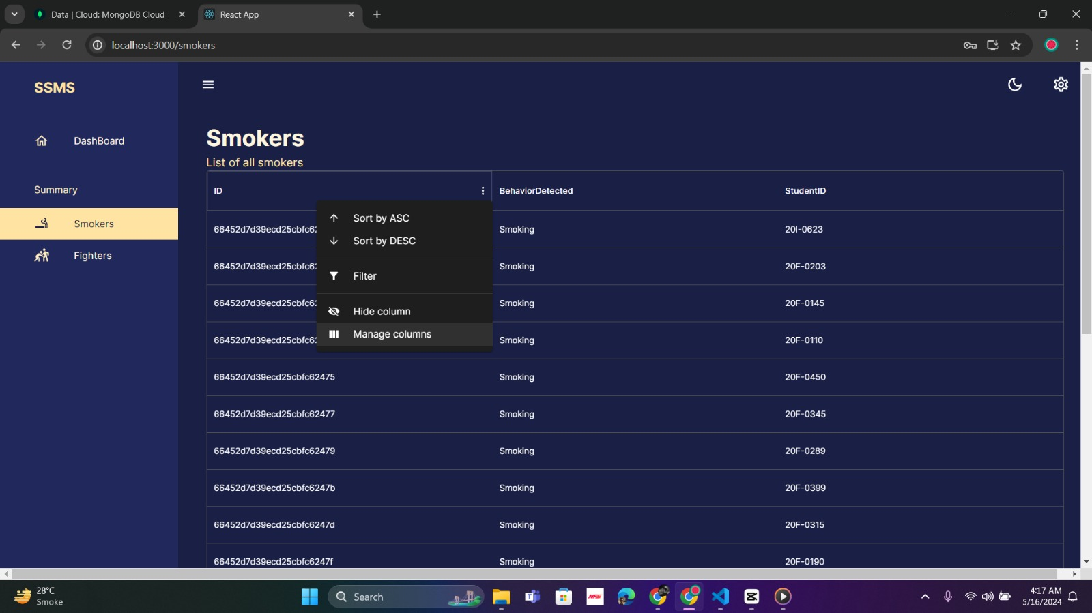
App Interface

Slide 26
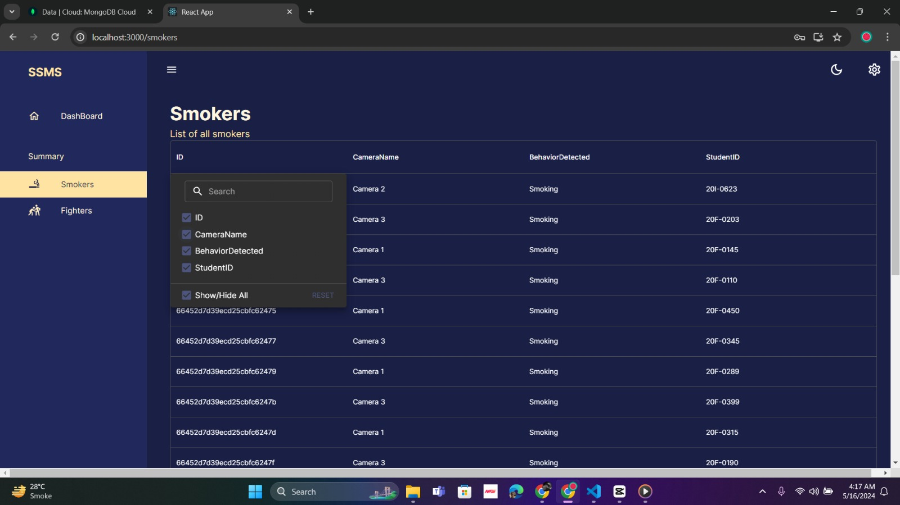
App Interface

Slide 27
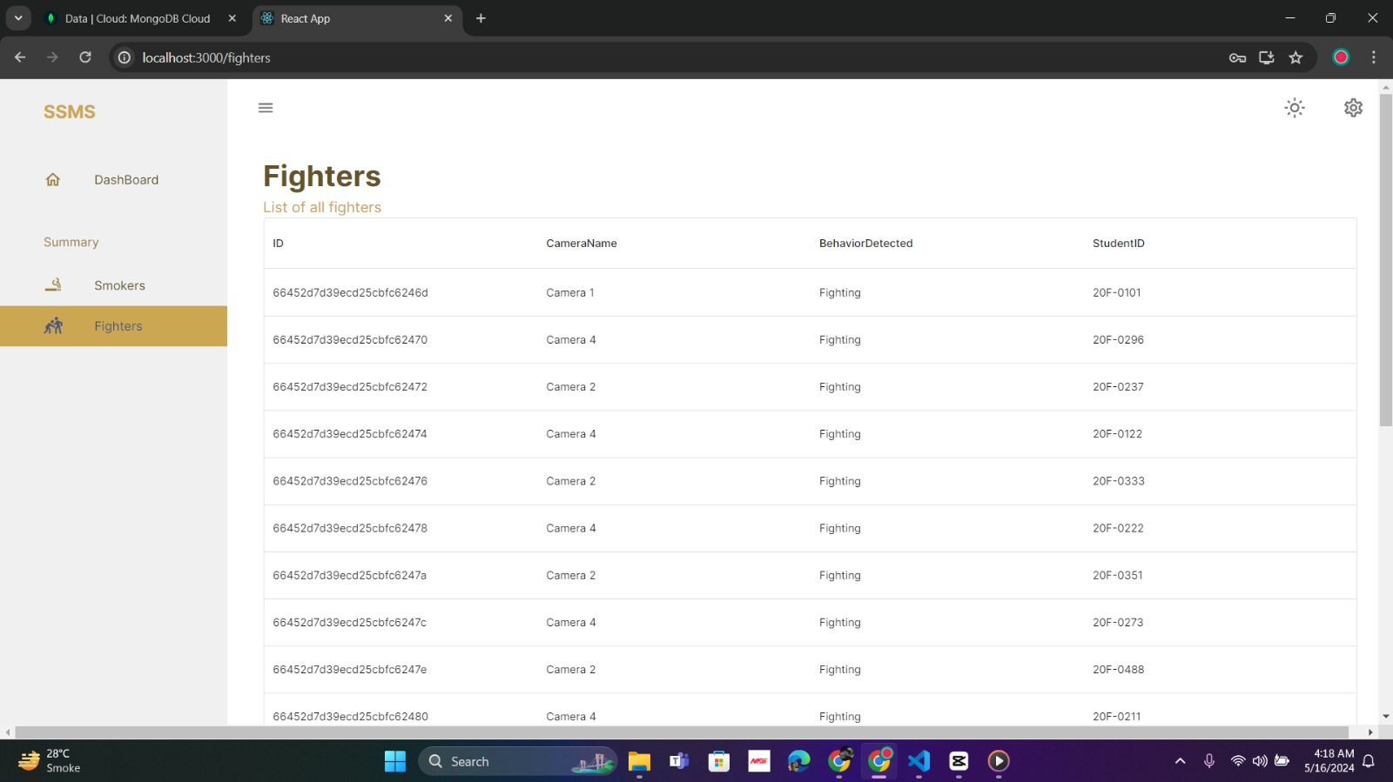
App Interface

Slide 28
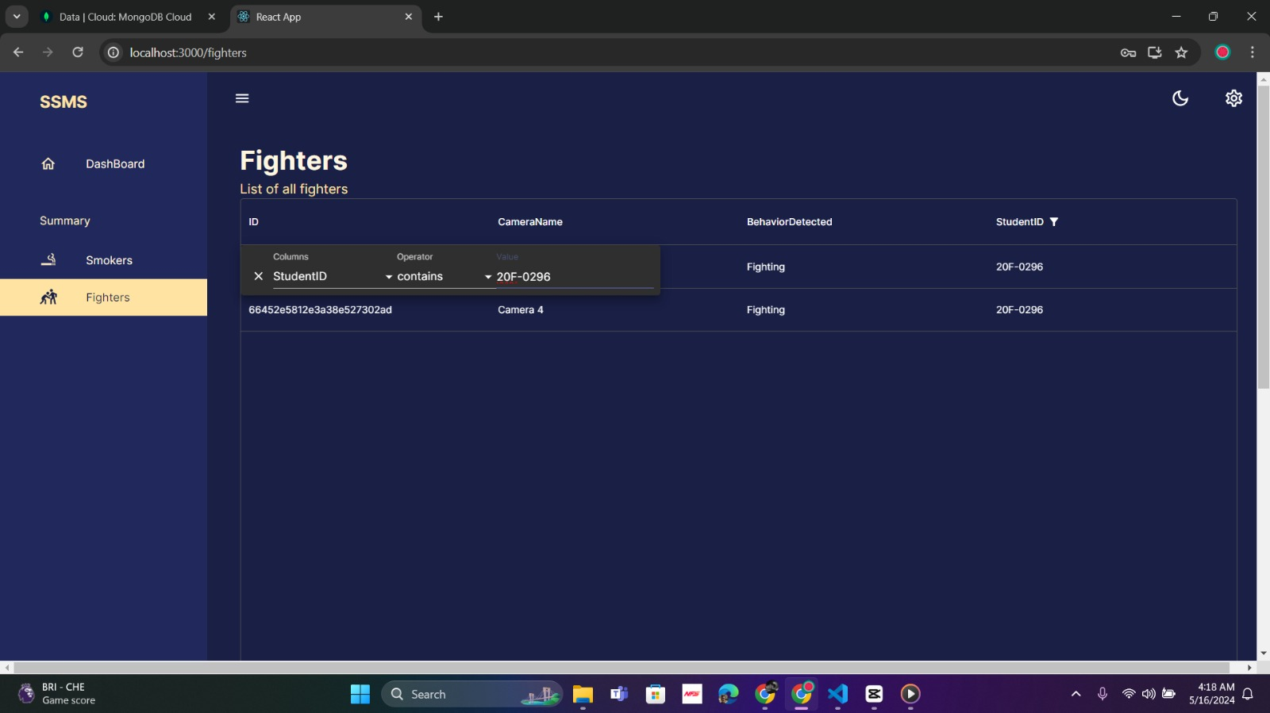
App Interface

Slide 29
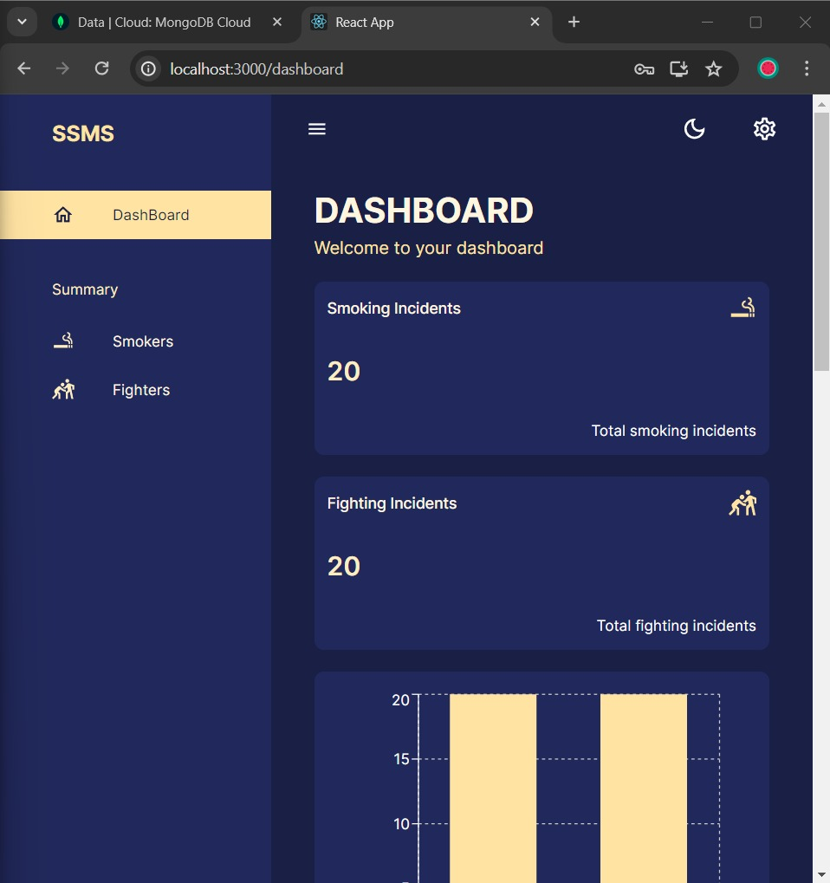
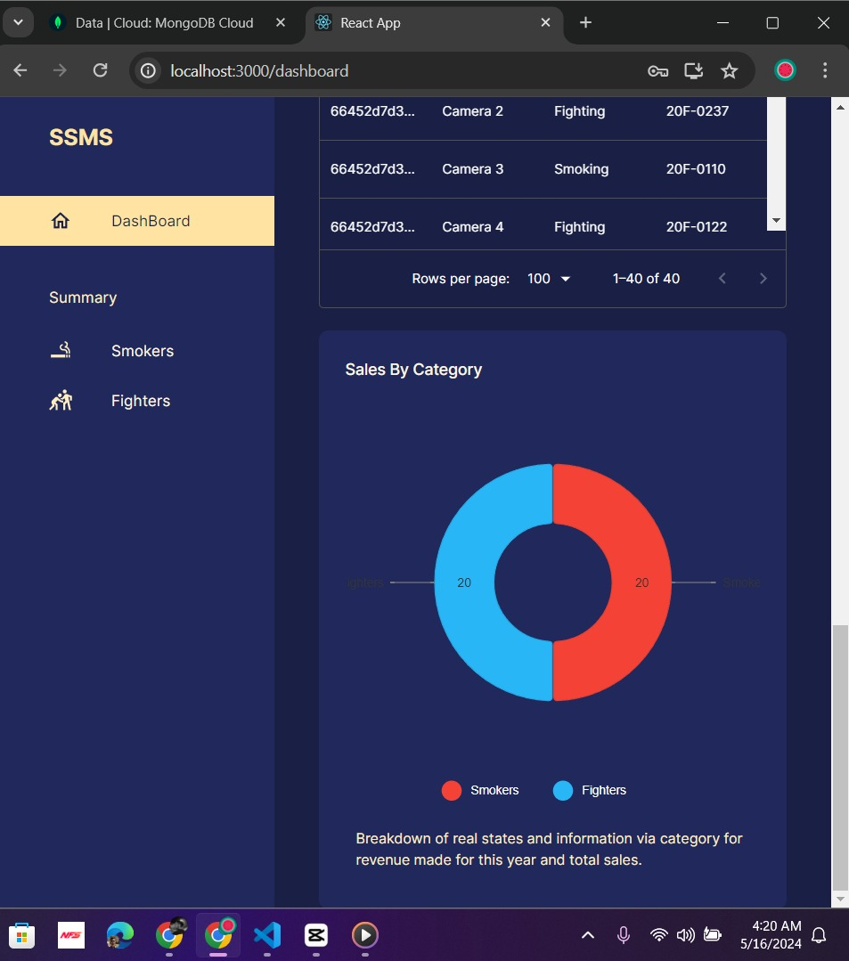
App Interface

Slide 30
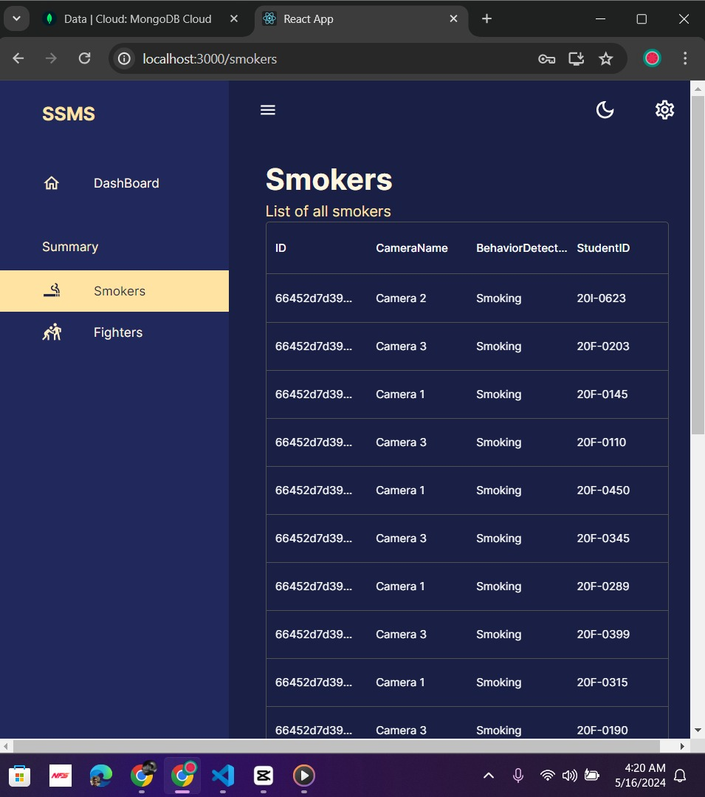
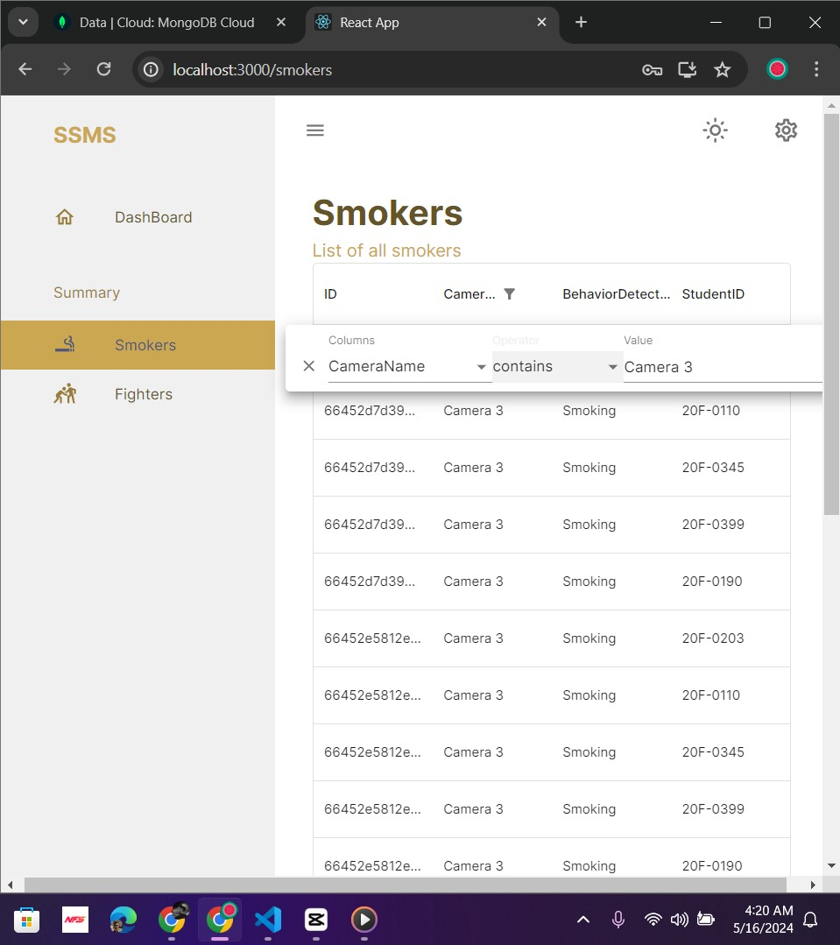
App Interface

Slide 31
Face Detection and Recognition Using face recognition Library
Loading Student Data:
Iterates over image files in the 'Students' directory.
Loads each image and computes face encodings using face_recognition.face_encodings.
Stores the computed face encodings and corresponding student rollnumbers.
Notes:
First point: CNN kay liye computational power resources run out.
DLIB: Dlib is a popular toolkit for machine learning that is used primarily for computer vision and image processing tasks, such as face recognition, facial landmark detection, object detection, and more. It is written in C++ but has Python bindings, making it easily accessible from Python code.

Slide 32
Face Detection and Recognition Using face recognition Library
RTSP Stream Processing:
Captures video frames from an RTSP stream using OpenCV.
Processes every 5th frame to enhance performance.
Resizes frames to 1/2 size to speed up face recognition processing while making sure that face recognition is done optimally.
Notes:
First point: CNN kay liye computational power resources run out.
DLIB: Dlib is a popular toolkit for machine learning that is used primarily for computer vision and image processing tasks, such as face recognition, facial landmark detection, object detection, and more. It is written in C++ but has Python bindings, making it easily accessible from Python code.

Slide 33
Face Detection and Recognition Using face recognition Library
Face Detection and Recognition:
Detects face locations in the resized frame using face_recognition.face_locations.
Computes face encodings for detected faces using face_recognition.face_encodings.
Compares these encodings with stored student encodings using face_recognition.compare_faces and face_recognition.face_distance.
Notes:
First point: CNN kay liye computational power resources run out.
DLIB: Dlib is a popular toolkit for machine learning that is used primarily for computer vision and image processing tasks, such as face recognition, facial landmark detection, object detection, and more. It is written in C++ but has Python bindings, making it easily accessible from Python code.

Slide 34
Face Detection and Recognition Using face recognition Library
Matching and Alerting:
If a match is found, it retrieves the corresponding student rollnumber.
Sends an alert to a server if a recognized face is detected and a certain count threshold is reached.
After sufficient time has passed since the last alert, a new alert is generated. This is done to avoid spamming on our web app.
Draws rectangles around detected faces and displays the rollnumbers on the video frames.
Notes:
First point: CNN kay liye computational power resources run out.
DLIB: Dlib is a popular toolkit for machine learning that is used primarily for computer vision and image processing tasks, such as face recognition, facial landmark detection, object detection, and more. It is written in C++ but has Python bindings, making it easily accessible from Python code.

Slide 35
Live Demo

Slide 36
Thank You

